Slide 1
Memento and Flyweight
More Pseudo code

Slide 2
Flyweight
The main idea of flyweight is the idea of pass by reference vs pass by value
Memory | Value
0x11A | 42
0x11B
0x11C
0x11D
Memory | Value
0x11A | 42
0x11B
0x11C | 42
0x11D
Pass by Value

Slide 3
Flyweight
The main idea of flyweight is the idea of pass by reference vs pass by value
Memory | Value
0x11A | 42
0x11B
0x11C
0x11D
Memory | Value
0x11A | 42
0x11B
0x11C | 0x11A
0x11D
Pass by Reference

Slide 4
Flyweight
For simple data this is trivial (and may be worse)
Storing a 2 byte reference to a 1 byte char is silly
HOWEVER storing a 2 byte reference instead of a 2MB image… that’s clever.

Slide 5
(bad) Flyweight Code
class Bird extends Enemy {
Flyweight bird = new Flyweight(“bird”);
long id = new getID(); double hp = Enemy.getHP(); }
class Flyweight{
public class Flyweight(String type){
switch (type){
case "bird":
return FlyweightBird();
break;
default:
return FlyweightThing();
}
} }
class FlyweightBird{
private final static mesh …
private final static Skills … }

Slide 6

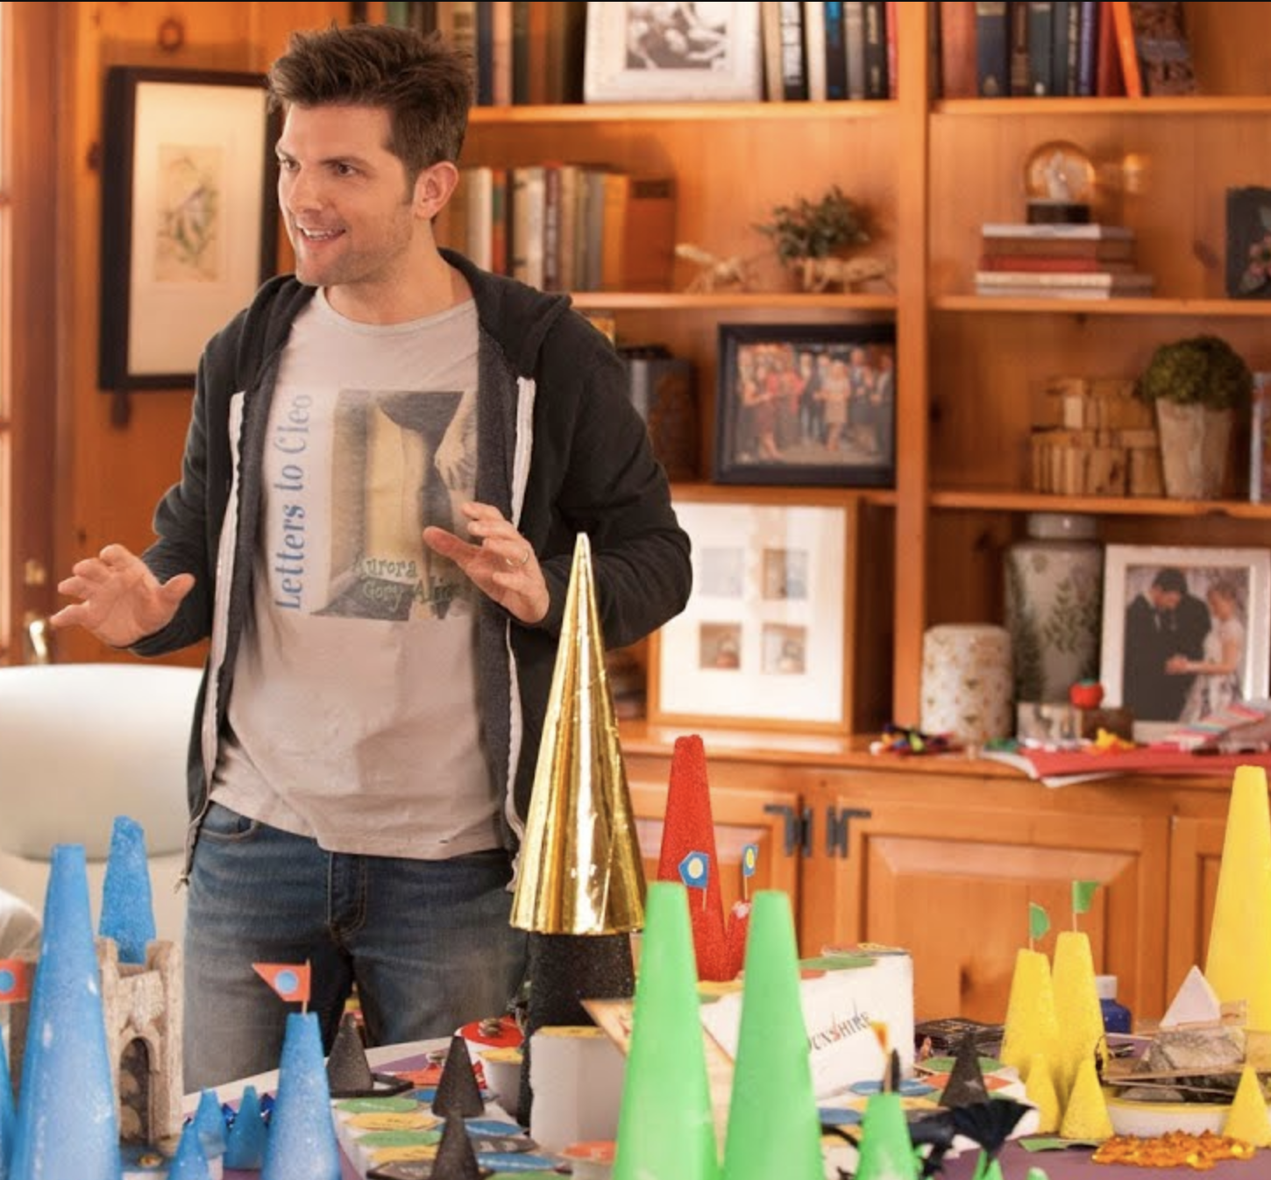
Memento
Memento is concerned with the opposite set of values
Memento is concerned with the unique properties whereas flyweight is only interested in the unique properties.

Slide 7
(meh) Memento Code
class Bird extends Enemy {
BirdMemento getMemento (){
return new BirdMemento(this.id, this.hp );
} }
class BirdSaver{
SaveBirds(List<BirdMemento> birds){
for( birdMemento m : birds){
savedBirds.put(m.getMemento());
}
writeBirds(savedBirds);
}
File writeBirds(List<birdMemento> savedBirds){…} }
class BirdMemento extends Memento{
private int id
private double hp }

Slide 8
Memento and bitwise encoding
Suppose we have an enum
Suppose that enum is used to encode something like fish in a simulator.
Instead of storing a reference to the fish, or worse the MESH of the fish, we can store its enum value…

Slide 9
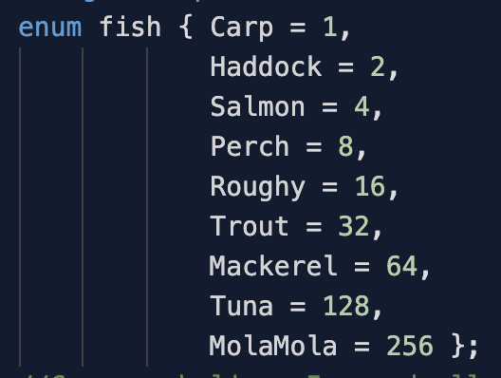
Bitwise OR
If we are using powers of two for our constants we can combine them without clobbering…
101010 == ??
What number is that in decimal?
What fish are represented by that binary number?

Slide 10
All that is not Saved is Lost
Now we can encode data in a way that is easy to save, transfer, and store.
We have to write methods that will translate an int to an object but we can DO that.
Bitwise operation in a loop with a switch statement and we are good to go.

Slide 11
Presentations
Starting Next Week I am going to have folks present some of these design patterns.
I will post a list of the design patterns to be presented
The presentation will be a combination of slides and code.
The code MUST be c++ (I know I am a jerk)
Our first presenter will get a small bonus for being first.

